Slide 1

Binary Search Trees Analysis
Ido Begun, Yael Golan & Idan Shabat

Slide 2

Binary Search Trees
A common database, used for storing data with comparable elements.
Integers, strings etc.
Abbr. BST
For each node with value d:
If a node in the left subtree has value d’: d’ ≤ d
If a node in the right subtree has value d’: d ≤ d’
6
2
6
-1
5
10

Slide 3
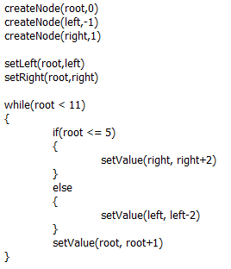
BST Programs
Programs that uses BSTs should keep them valid, while supporting operations like:
Insertions
Setting values
Setting children
Goal: given such program, verify that all of the BSTs created in it are valid (at the end point of the run).

Slide 4
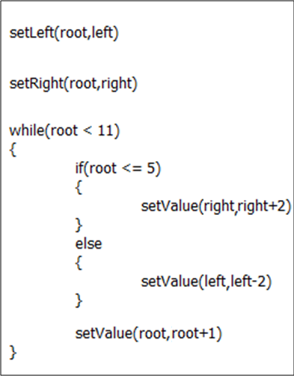
The CFG Algorithm
Create the CFG of the program.

Slide 5
The CFG Algorithm
Initialize all the CFG nodes with the empty abstract state.
ε
ε
ε
ε
ε
ε
ε
ε
ε
ε

Slide 6
The CFG Algorithm
Choose a node in the CFG and update it:
For nodes after if or else: State = Previous State П Boolean Statement, or State = Previous State П !(Boolean Statement)
For nodes after if blocks, and before while: State = Previous States
For nodes after other commands: State = [command]#(Previous State)
Continue the process (according to a certain order of the CFG nodes), until a fix point is reached, or until we had enough iterations.
П

Slide 7
Assumptions on the Program
The values of the BST nodes are integers.
The following commands are supported:
createNode(n,d) – creates a new node with value d.
setLeft(n,n’) – sets the left child of n to be n’.
setRight(n,n’) – sets the right child of n to be n’.
setValue(n,d) – sets the value of n to be d.
setValue(n,n+d) – increments the value of n by d.
setValue(n,n-d) – decrements the value of n by d.
The programs use the commands properly:
There is no createNode(n,d) if n is already created.
There is no setLeft(n,n’) or setRight(n,n’) if n already has a left or right child, respectively.
All nodes names inside the set-commands should exist.

Slide 8
Concrete States Lattice
N denotes the set of nodes in the program.
N⁺ = N ᴜ {null}
A concrete state is a finite set of partial functions s: N → N⁺× Z × N⁺
If s(n) = (n_{l} , d , n_{r}), then s(n_{l}) and s(n_{r}) are defined.
Partial order:
Join: , Meet:
Bottom: ø
Top: T - A special additional element.
Ul
U
U

Slide 9

BST-strings
A BST-string is made of matched parentheses, and represents a BST:
Join (of BST-strings): V =
n₀
4-5
((n₁[0-2]) n₀[4-5](n₂[6-6]))
n₁
n₂
0-2
6-6
n₀
n₀
n₀
4-4
4-5
4-5
n₁
n₁
n₂
n₁
n₂
0-1
2-2
6-6
0-2
6-6

Slide 10
BST-strings
And what if there are different nodes in the same location in the trees? V =
n_{τ} is a “general node” – may represent each node in N.
For two BST-strings w₁,w₂: w₁≤w₂ ↔ w₂=w₁ V w₂
Meet is defined analogously.
meet of two different nodes = the empty string.
n₀
n₀
n₀
4-4
4-5
4-5
n₁
n₃
n₂
n_{τ}
n₂
0-1
2-2
6-6
0-2
6-6

Slide 11

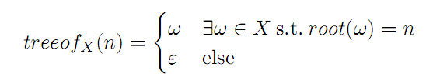
Abstract States Lattice
An abstract state is a set of BST-strings.
Different BST-strings don’t have the same root.
Partial order:
Join:
where:
Meet is defined analogously.
Bottom: ø
Top: τ - A special additional element.

Slide 12

The Galois Connection
α – Use function down on root nodes.
Given s and a node n, s.t. s(n) = (n_{l} , d , n_{r}), down_{s}(n) = (down_{s}(n_{l}) n[d-d] down_{s}(n_{r}))
down_{s}(null) = ε
n is a root node of s if it has no parent in s
i.e. no n’ satisfy s(n’)=(n,…) or s(n’)=(…,n)
Only for S without “cycles”. For such S: α(S) = τ

Slide 13

The Galois Connection
γ – Can be defined automatically by α.
n₀
n₀
4-5
6-9
n₁
n₂
n_{τ}
0-2
6-6
1-4
n₀
n₀
n₀
n₀
4
5
9
8
n₀
n₀
n₁
n₂
n₀
4
n₅
n₁
1
6
5
3
7
1
n₂
n₁
n₂
6
0
6

Slide 14
Transformers – Create Node
The concrete transformers ignore s’s that aren’t valid to the next command.
E.g, if s(n) is defined, [createNode(n,d)] will ignore s.
For an abstract state X:
n₀
n₃
n₀
n₃
4-5
6-9
[createNode(n₀ ,7)]#
4-7
6-9
n₁
n₂
n_{τ}
n₁
n₂
n_{τ}
0-2
6-6
1-4
0-2
6-6
1-4
n₀
n₃
n₀
n₃
n₄
4-5
6-9
[createNode(n₄ ,3)]#
4-5
6-9
3-3
n₁
n₂
n_{τ}
n₁
n₂
n_{τ}
0-2
6-6
1-4
0-2
6-6
1-4

Slide 15
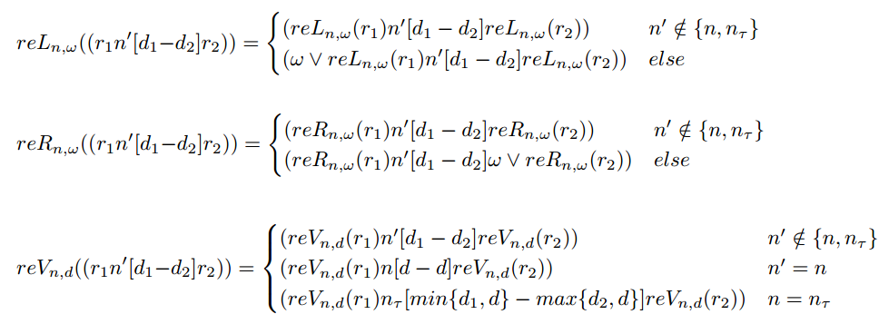
Replacement Functions
For the set-commands, we define replacement functions:
In words:
reL_{n,w} joins the existing left children of n with w.
reR_{n,w} joins the existing right children of n with w.
reL_{n,d} joins or replaces the existing value of n with d.

Slide 16
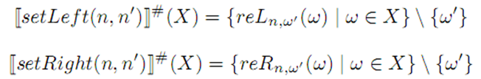
Transformers – Setters
For an abstract state X, if w’=treeof_{X}(n’):
n₃
6-9
n₄
n₀
n₃
n₀
n₀
0-0
4-5
6-9
[setLeft(n₀ , n₄ )]#
4-5
1-4
n₁
n₂
n₀
n_{τ}
n₂
n₄
1-2
6-6
1-4
0-2
6-6
0-0
n₃
6-9
n₄
n₀
n₃
n₀
n_{τ}
0-0
4-5
6-9
[setRight(n₀ , n₄ )]#
4-5
1-4
n₁
n₂
n_{τ}
n₁
n_{τ}
n₄
1-2
6-6
1-4
0-2
0-6
0-0
n₀
n₃
n₀
n₃
4-5
6-9
[setLeft(n₂ , n₇ )]#
4-5
6-9
n₁
n₂
n_{τ}
n₁
n₂
n_{τ}
0-2
6-6
1-4
0-2
6-6
1-4

Slide 17
Transformers – Setters
For an abstract state X, if w’=treeof_{X}(n’):
n₀
n₁
n₀
n₁
4-5
6-9
[setValue(n₁ ,5)]#
4-5
5-5
n₁
n₂
n_{τ}
n₁
n₂
n_{τ}
0-2
6-6
1-4
5-5
6-6
1-5
n₀
n₁
n₀
n₁
4-5
6-9
[setValue(n₄ ,0)]#
4-5
6-9
n₁
n₂
n_{τ}
n₁
n₂
n_{τ}
0-2
6-6
1-4
0-2
6-6
0-4
n₀
n₁
n₀
n₁
4-5
6-9
[setValue(n₄ ,0)]#
4-5
6-9
n₁
n₂
n₃
n₁
n₂
n₃
0-2
6-6
1-4
0-2
6-6
1-4

Slide 18

Transformers
All of the abstract transformers are sound, with respect to their matched concrete transformers.
i.e. for all X:

Slide 19
Questions?
Thank you

